Slide 1
Deep Learning

Slide 2
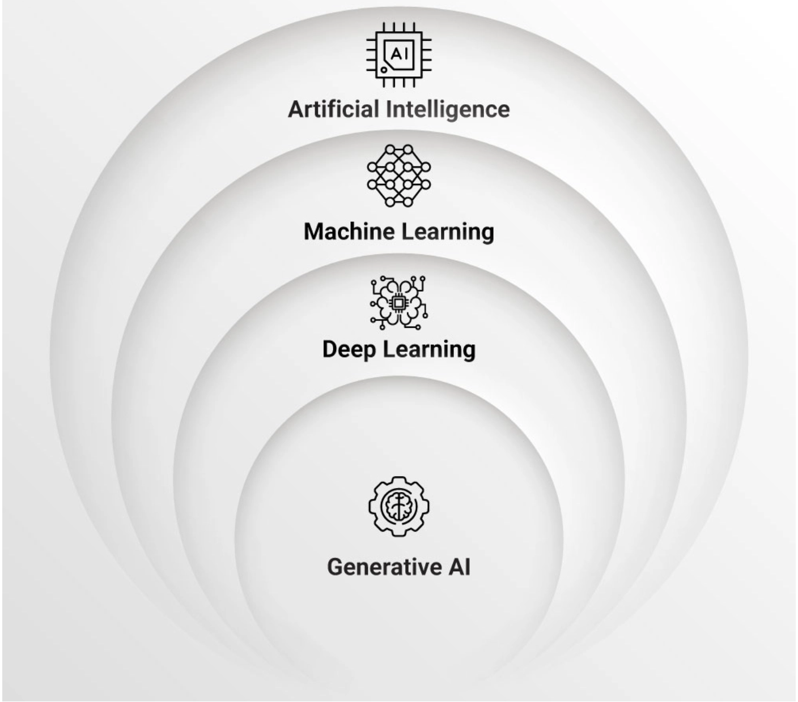
Intro
AI -The umbrella Term
The broadest concept, aiming to create machines that can simulate human-like intelligence, including problem-solving, learning, decision-making, and understanding.
Machine Learning (ML)- Teaching AI to learn from data
Can we classify / predict/ forecast the future based on historic data patterns
Deep Learning
Subset of ML which is Brain/Neuron Inspired
A specialized area of machine learning utilizing multi-layered neural networks inspired by the human brain to learn from vast amounts of data.
Generative AI -Creating new content
Deep Learning/Transformer based AI focused on creating new,
original content (e.g., text, images, music, videos)
by learning patterns from existing data

Slide 3
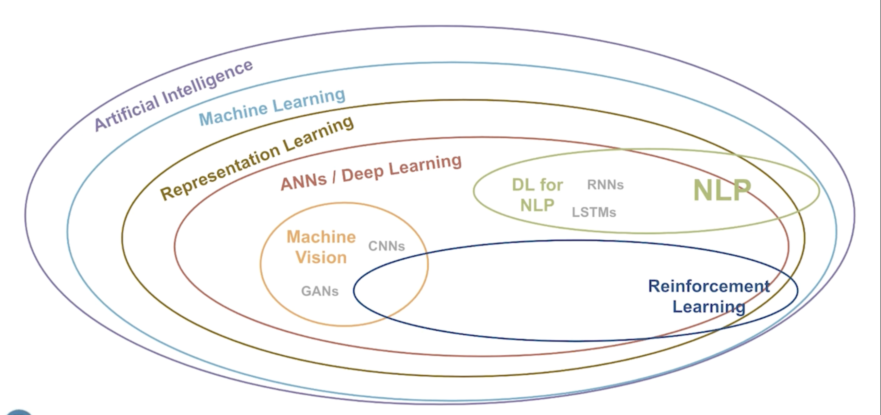
Deep Learning
Transformers

Slide 4
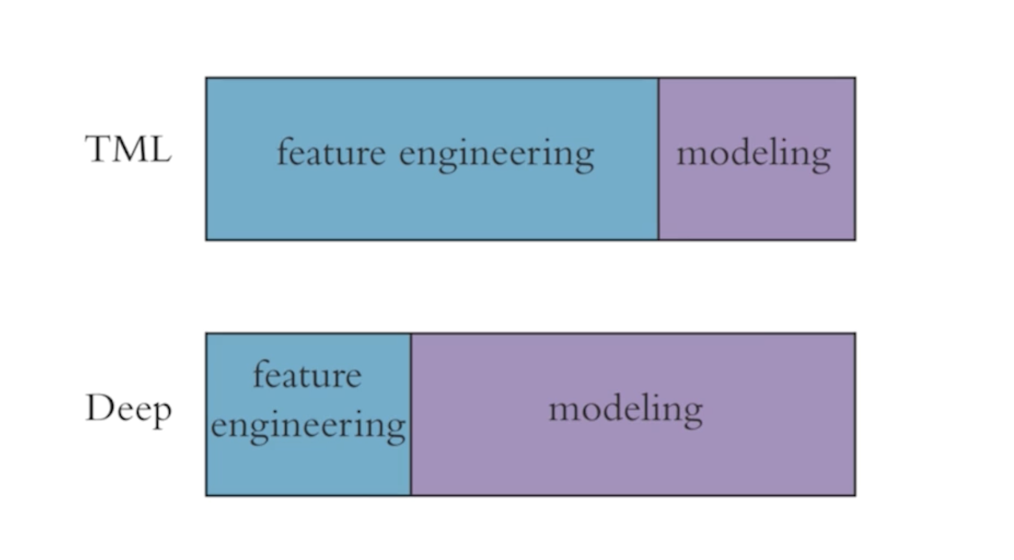
Deep Learning Vs Traditional ML
Deep Learning /Neural Network Algorithm Training involves Back Propagation to auto tune weights to optimize loss function
Trade Off :
Explainability

Slide 5
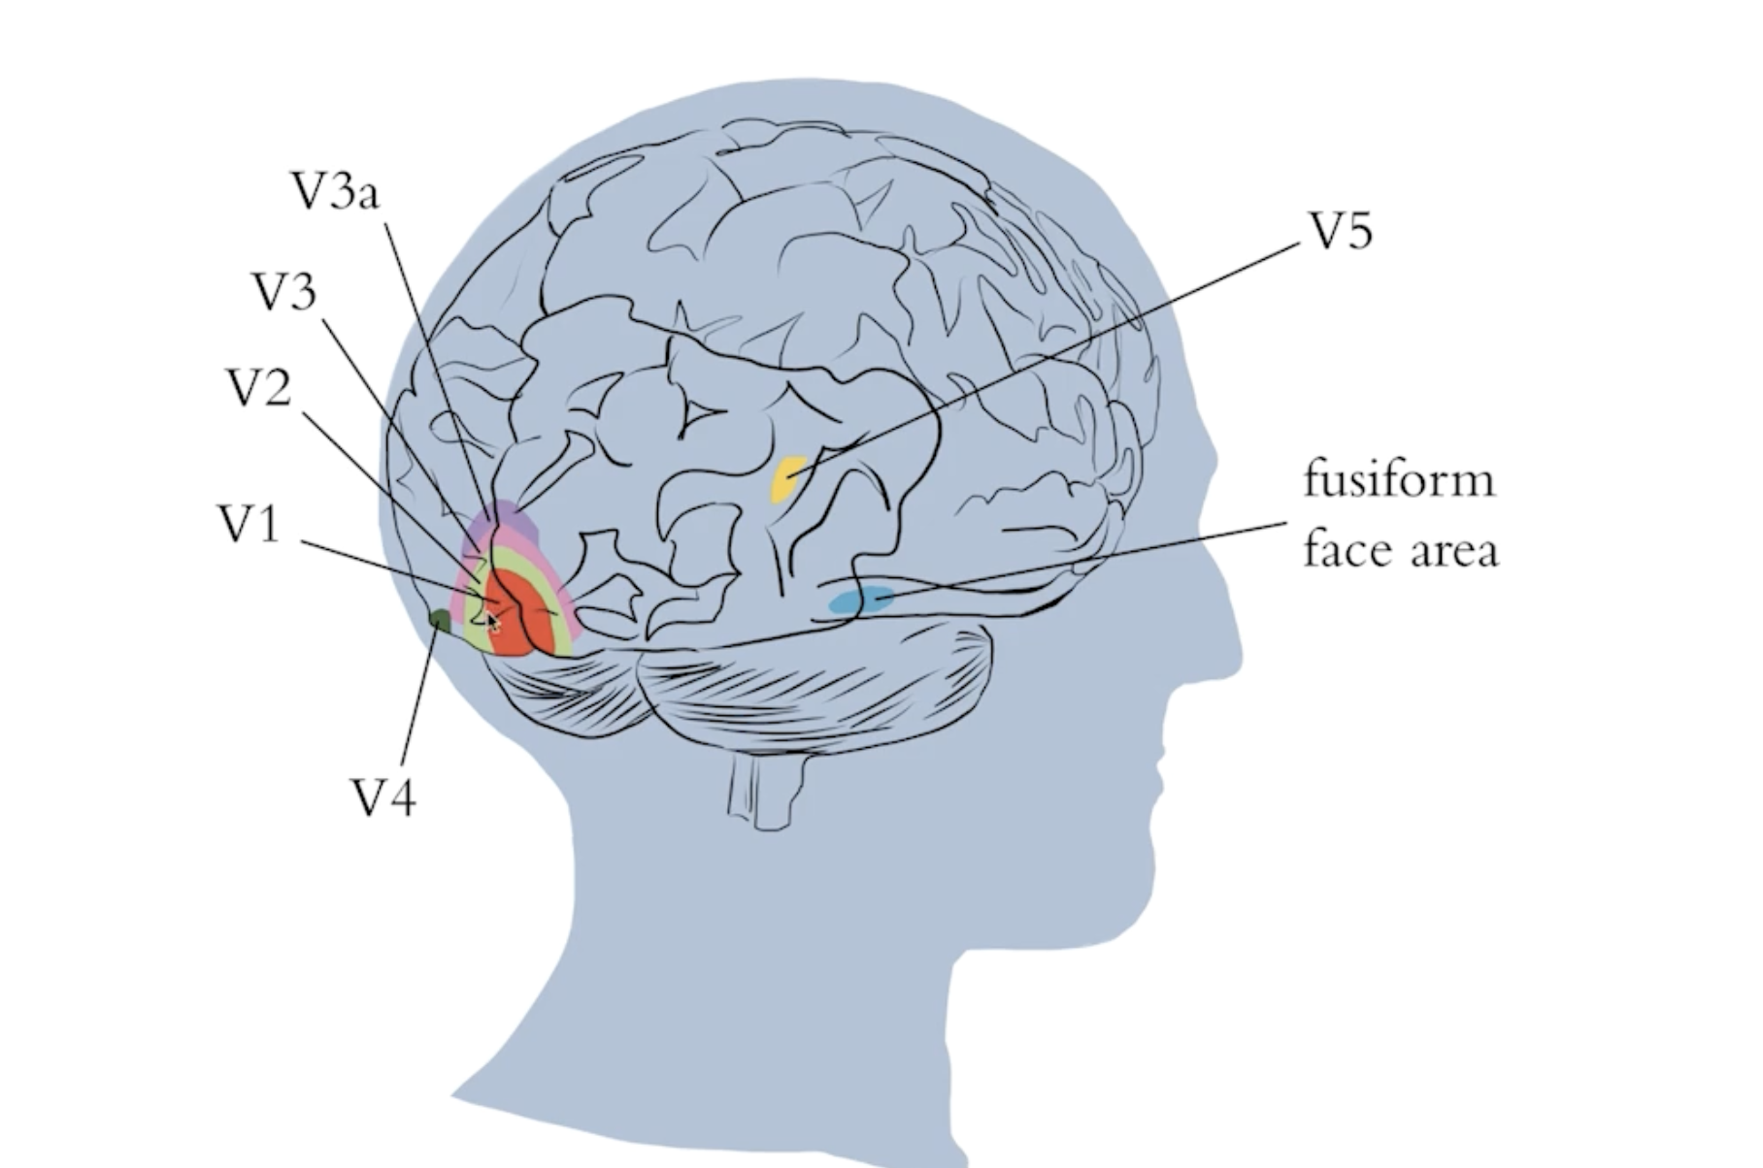
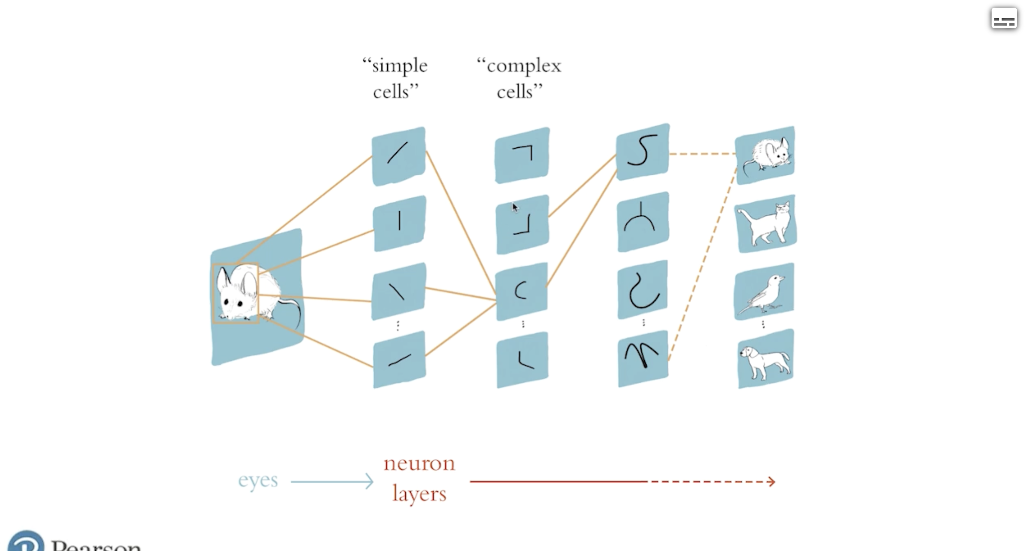
Deep Learning Inspiration

Slide 6
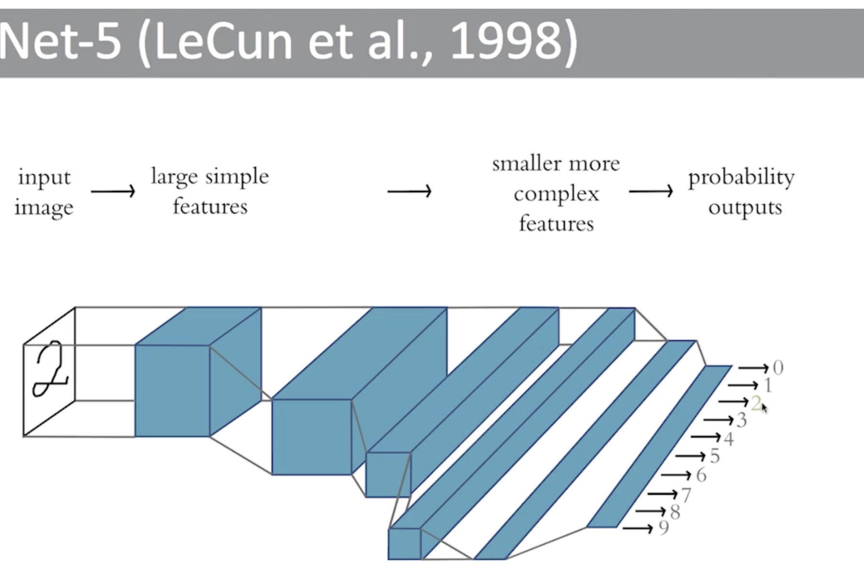
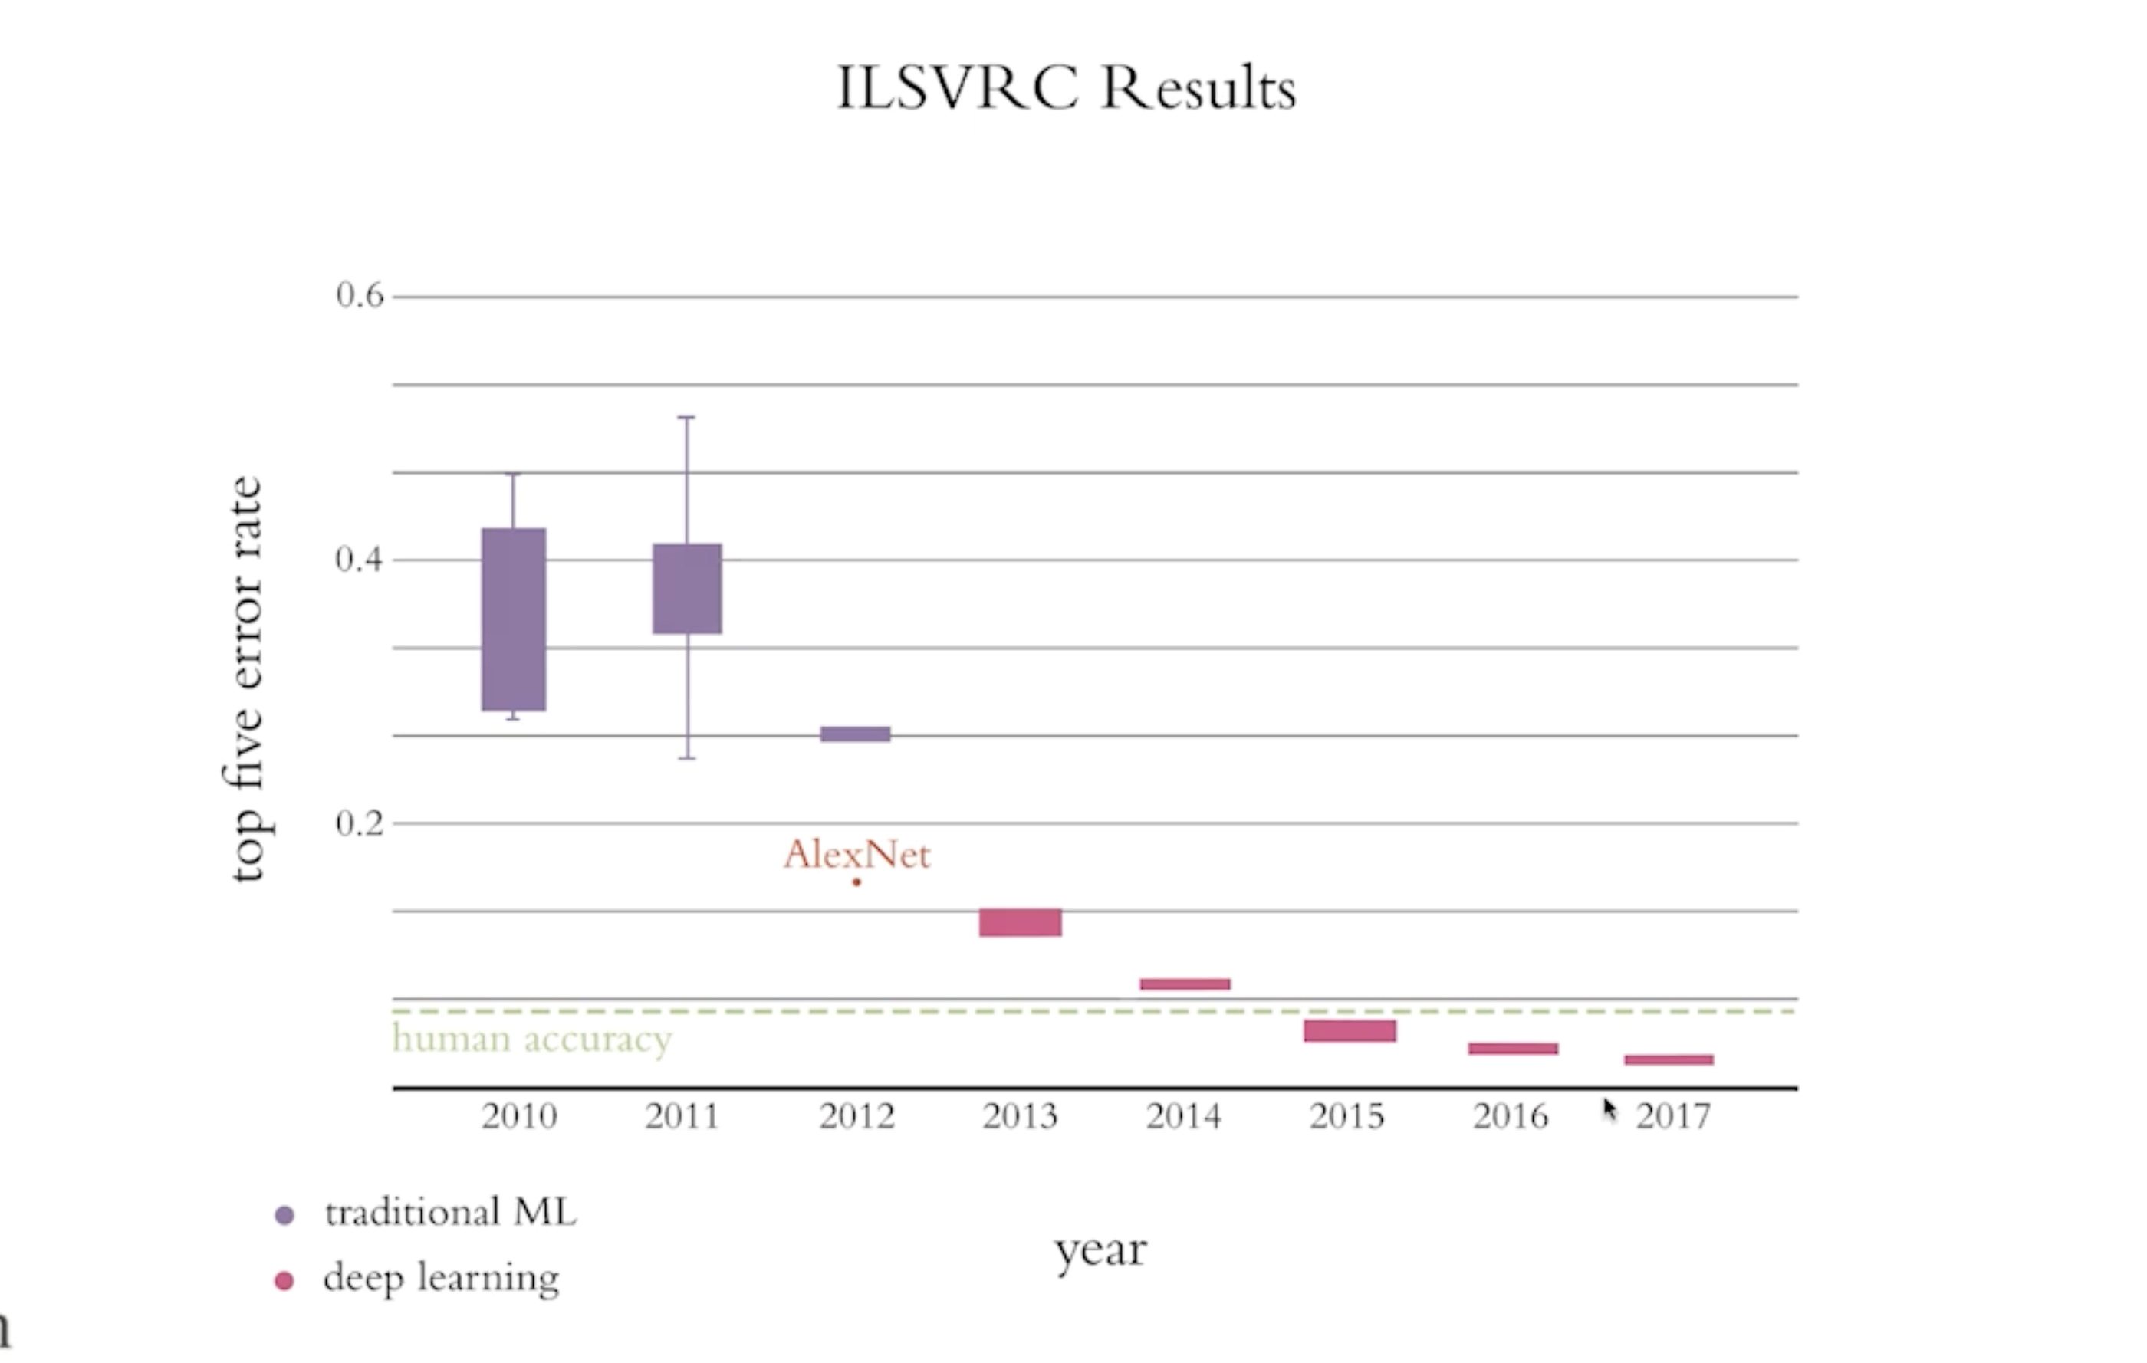
Break Throughs

Slide 7
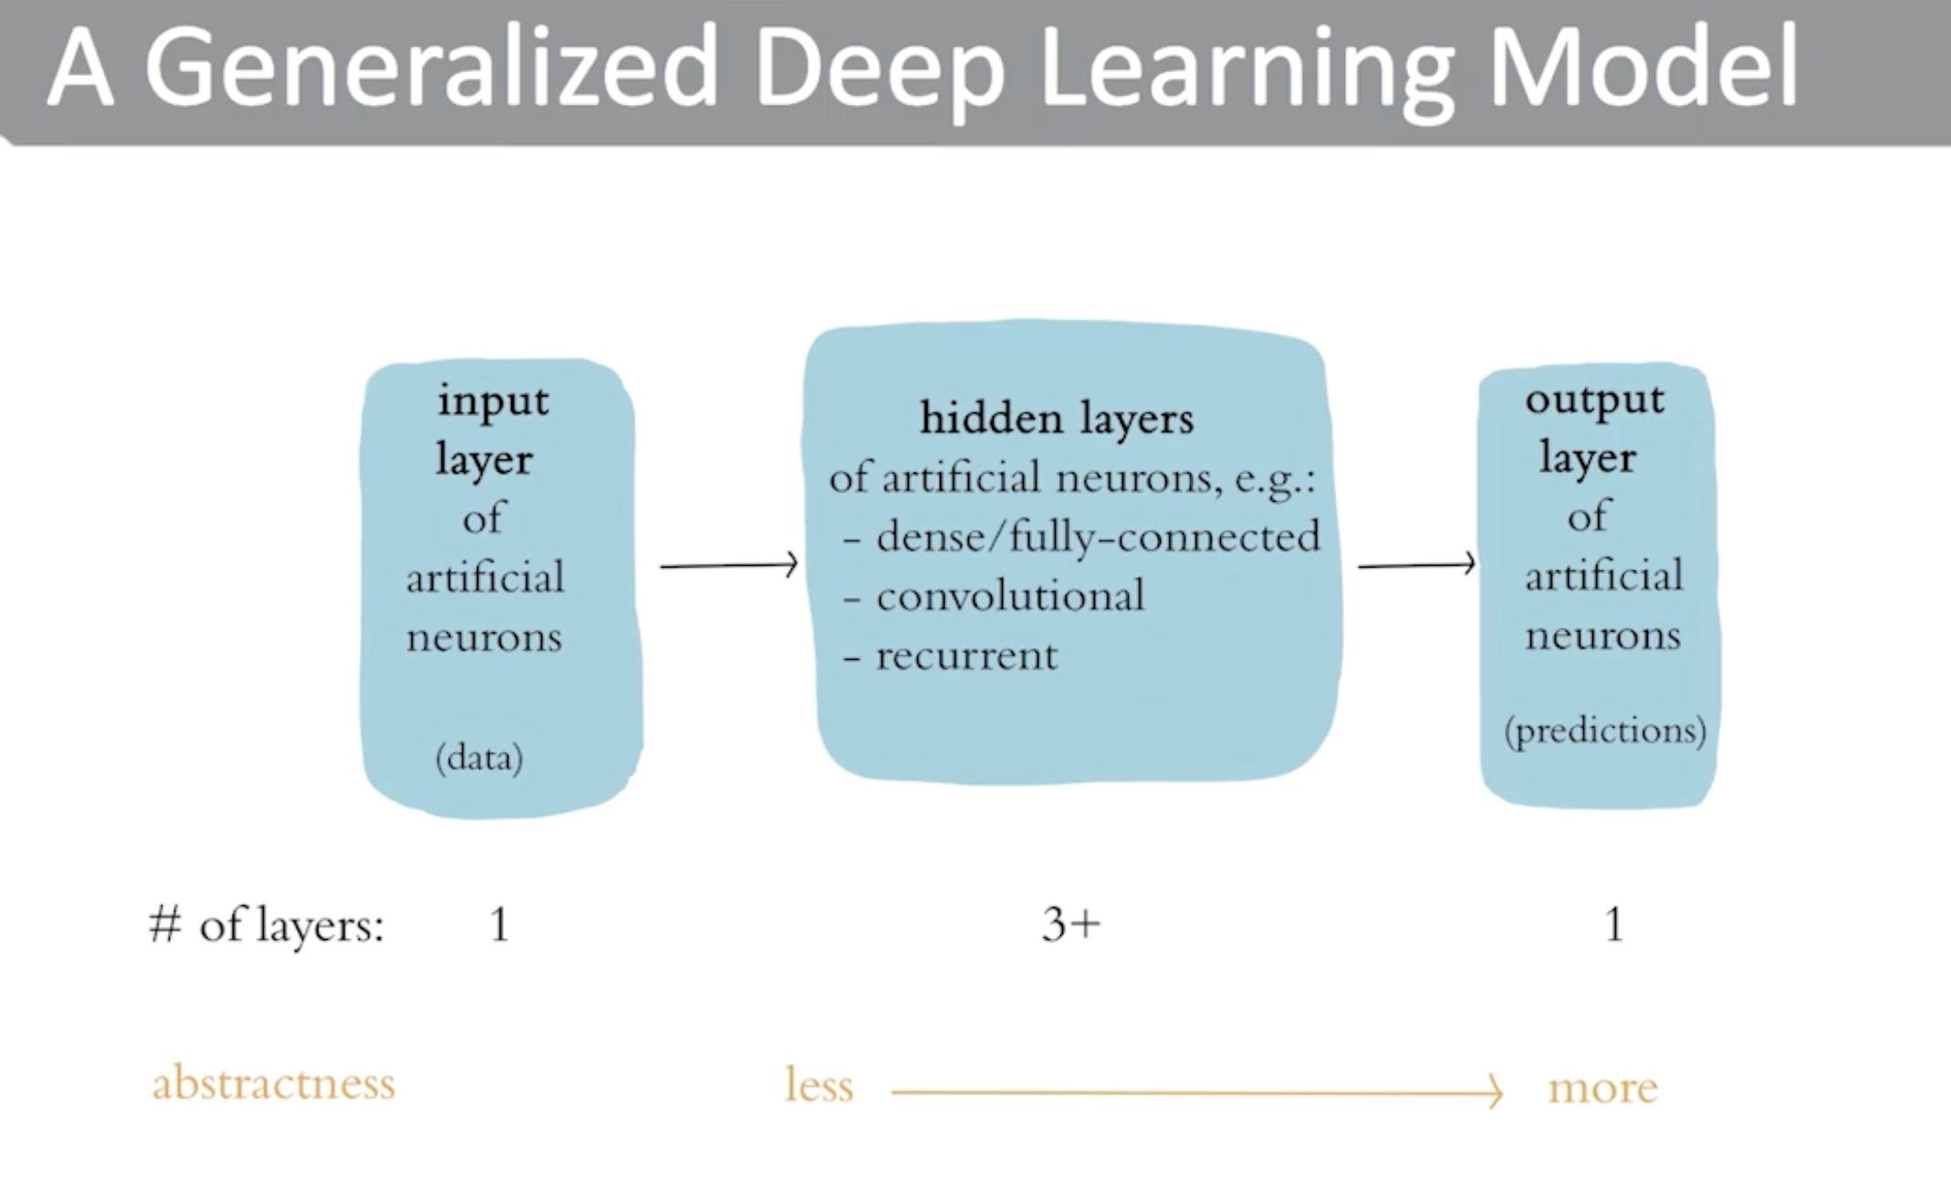
Deep Learning Architecture
Dense Layer : Receives Information from all previous Layer

Slide 8
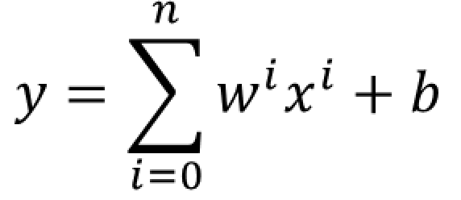
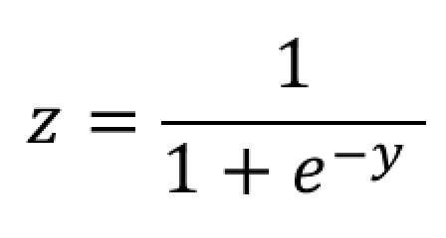
Neuron
x1
w1
0 to 1
x2
w2
Weighted Sum
Activation Function

Slide 9
Example
Ketchup
1
W1=3
If weighted sum >4 then Hot Dog else not
Hot Dog or not
Mustard
W2=1
1
Weighted Sum
Activation Function
W3=5
Bun
Bias =-2
0

Slide 10
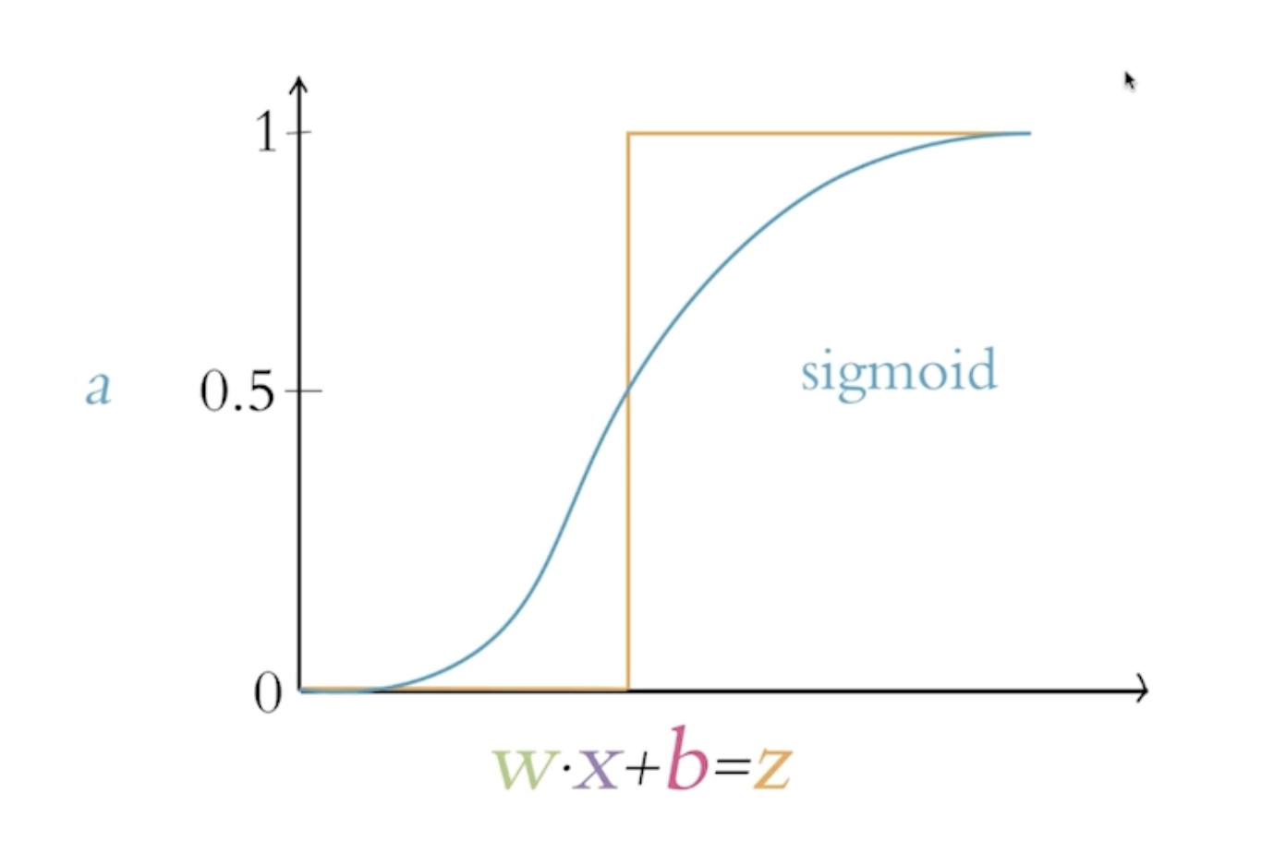
Activation Functions
To Bring Non Linearity to Neuron
Activation Functions
Sigmoid – Converts output from 0 to 1 .
Used in Output Layer
Tanh – Same as Sigmoid . But output from -1 to 1
RELU – Popular for hidden layer.
Fast and Addresses vanishing gradient .(Max(0, value))

Slide 11
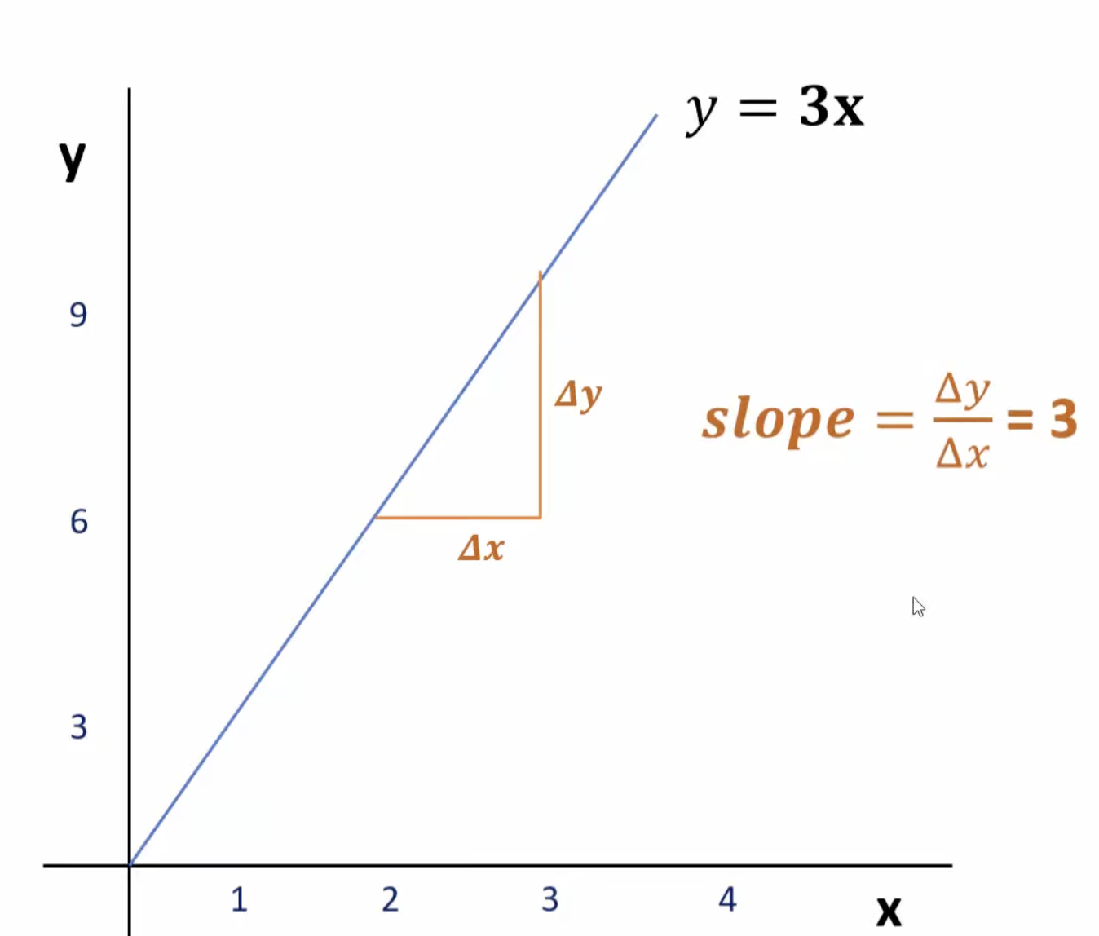
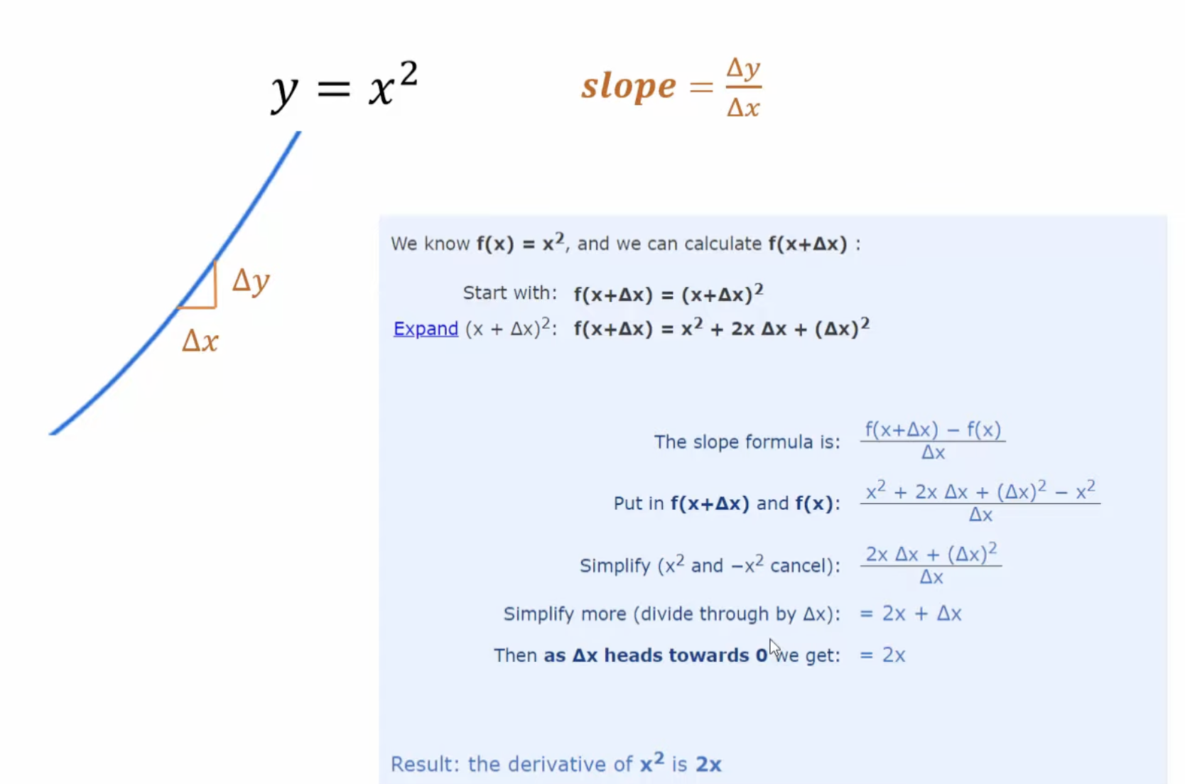
Derivatives (Primer)
https://www.mathsisfun.com/calculus/derivatives-introduction.html

Slide 12
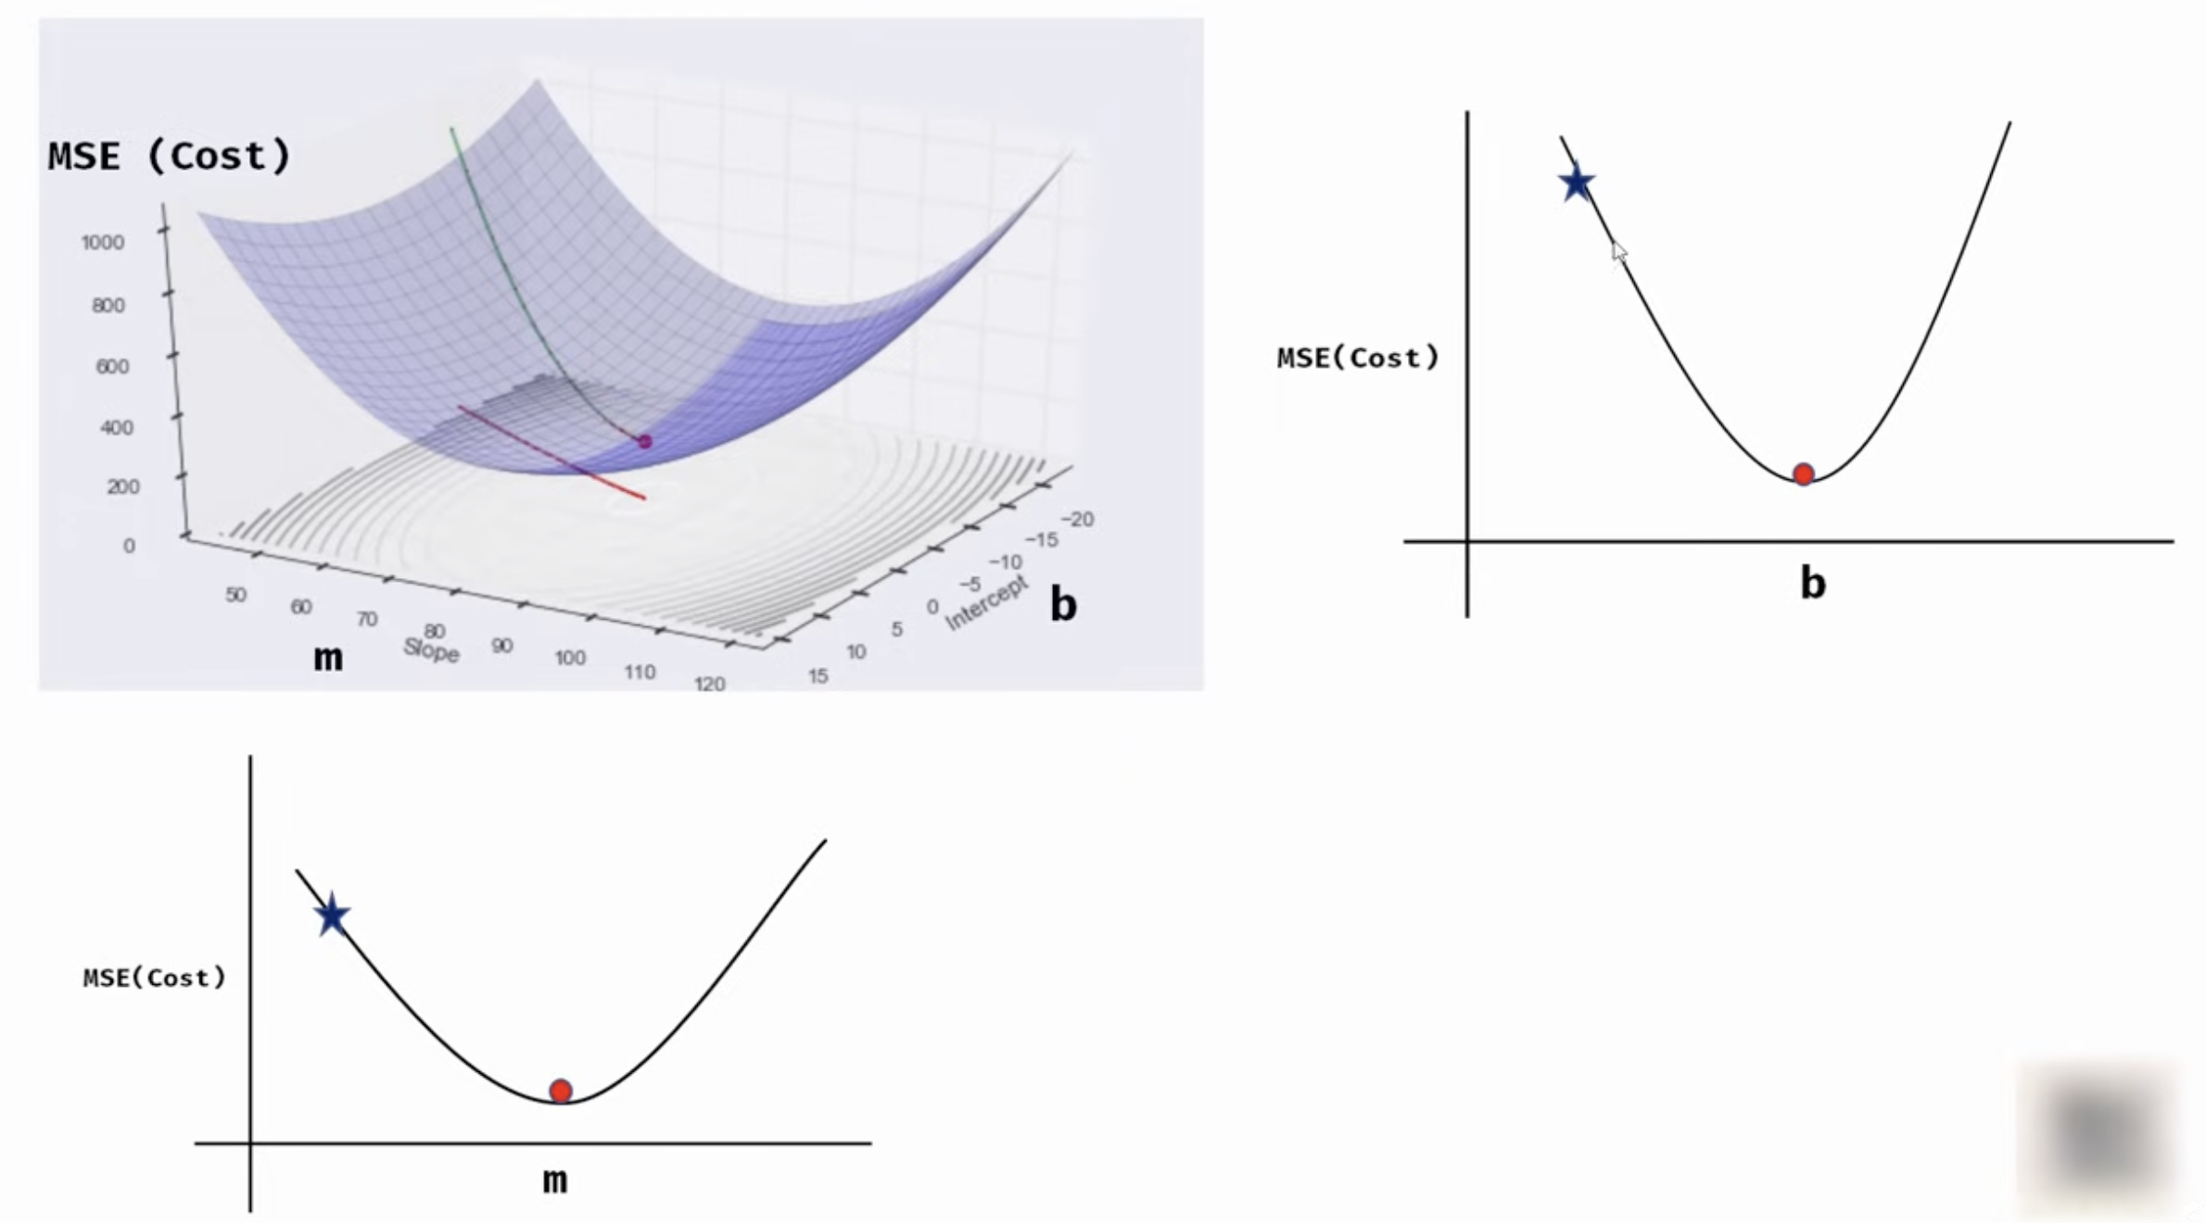
Gradient Descent

Slide 13
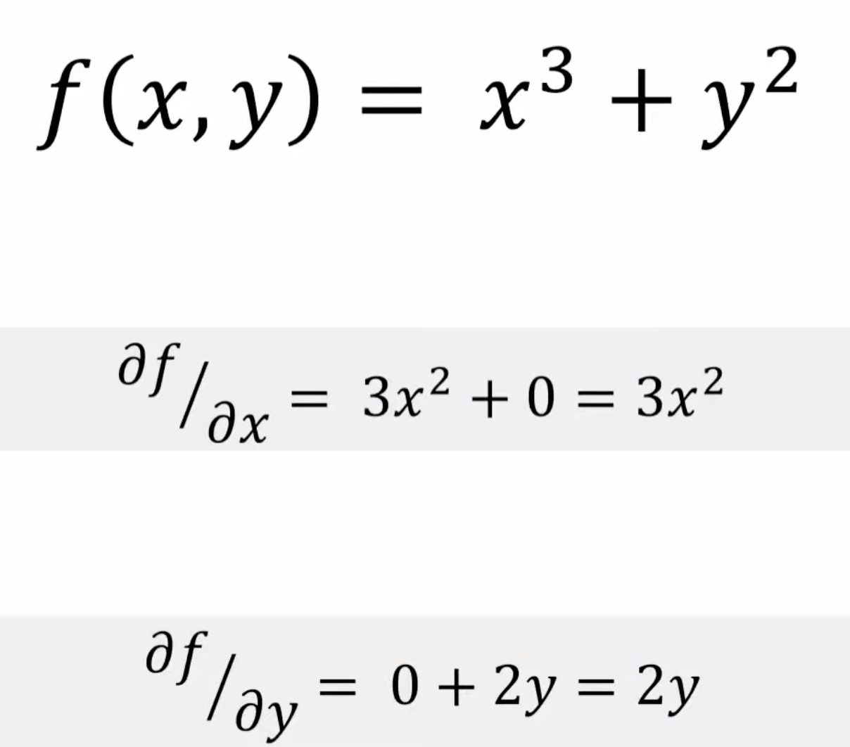
Partial Derivatives
How much Prediction changes when change in Ketchupiness/Mustardiness
F(HotDogOrNot)= Ketchupiness*3+Mustard*2
Derivate(HotDog/Ketchupiness) = 3*Ketchupines*2
Derivate(HotDog/mustardy) = 2*Mustardiness

Slide 14
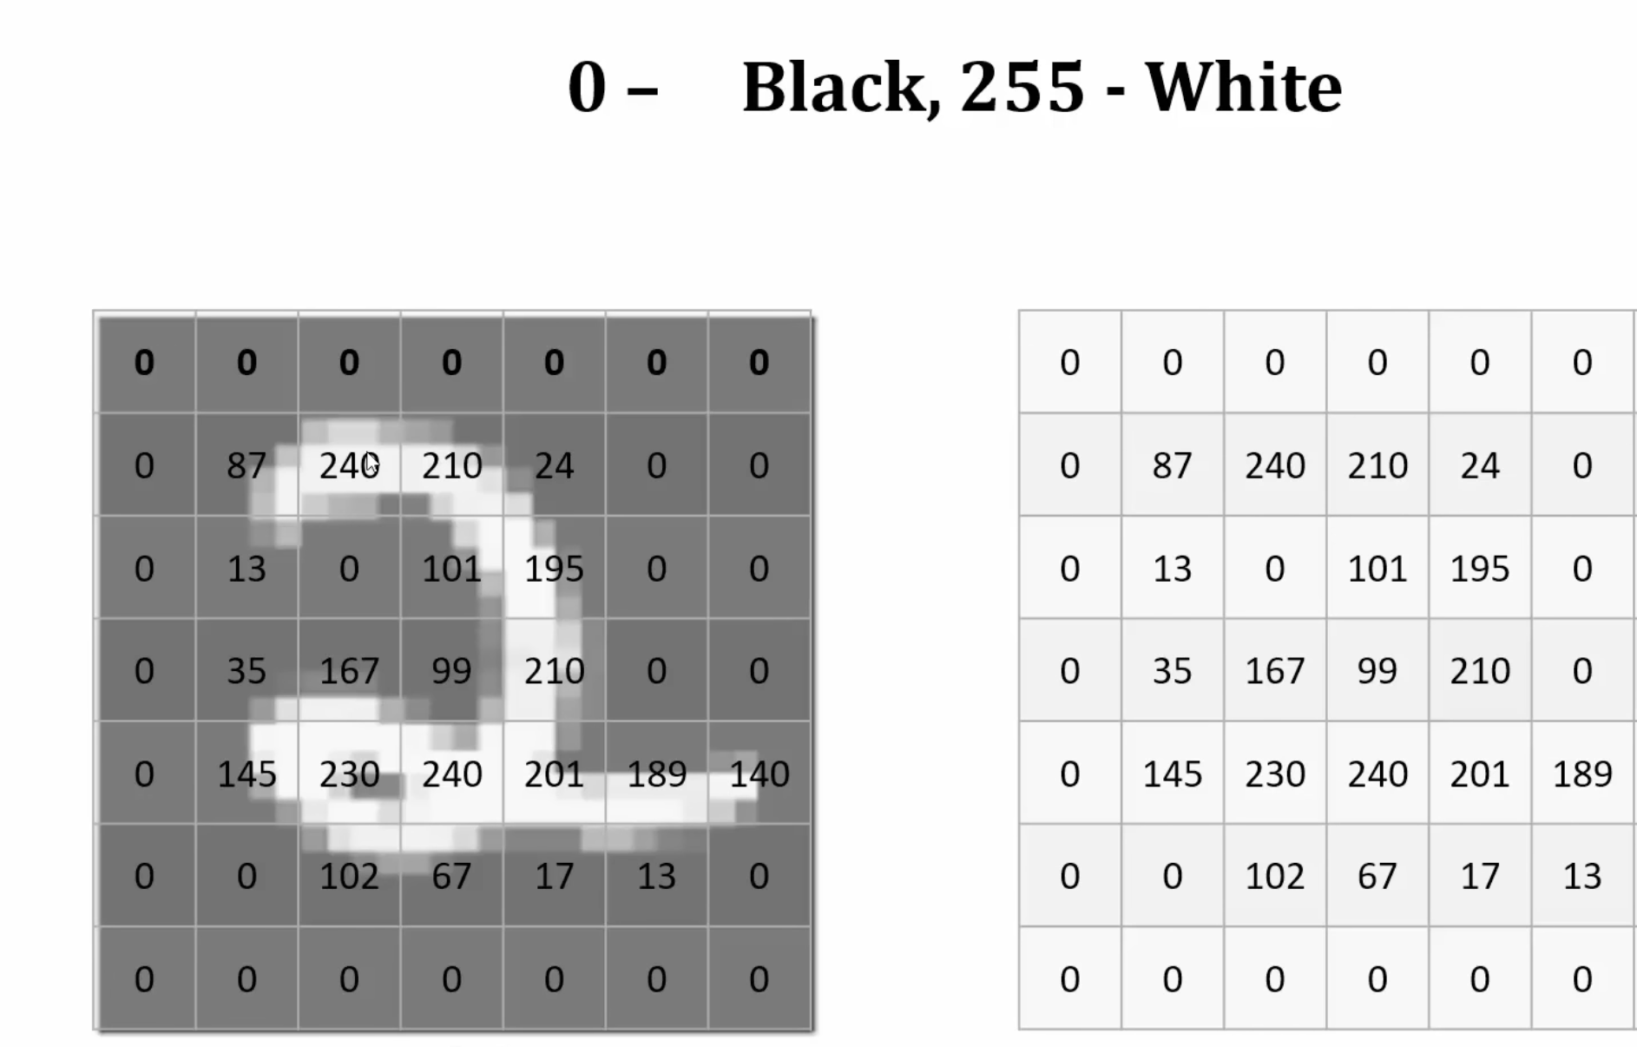
Demo Problem Statement

Slide 15
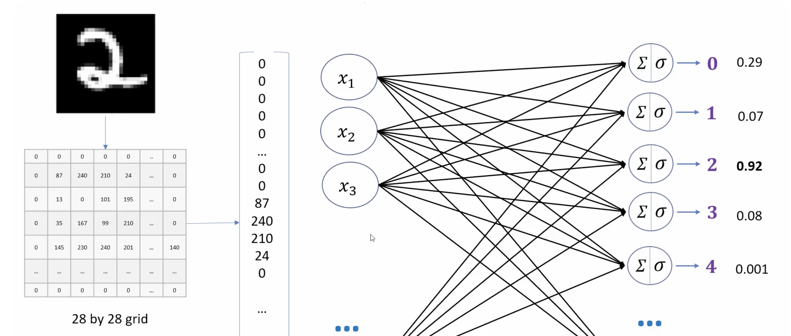

Slide 16
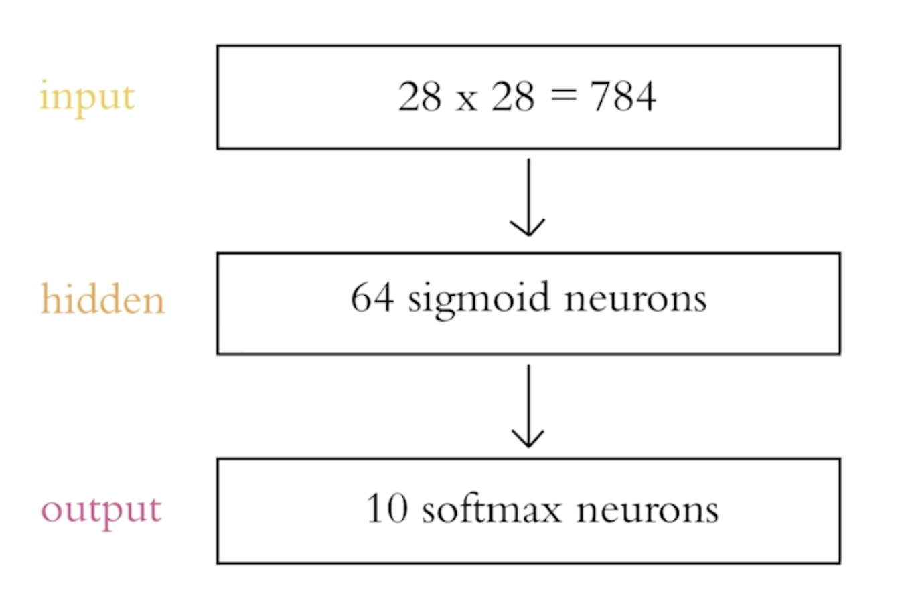
Layers

Slide 17
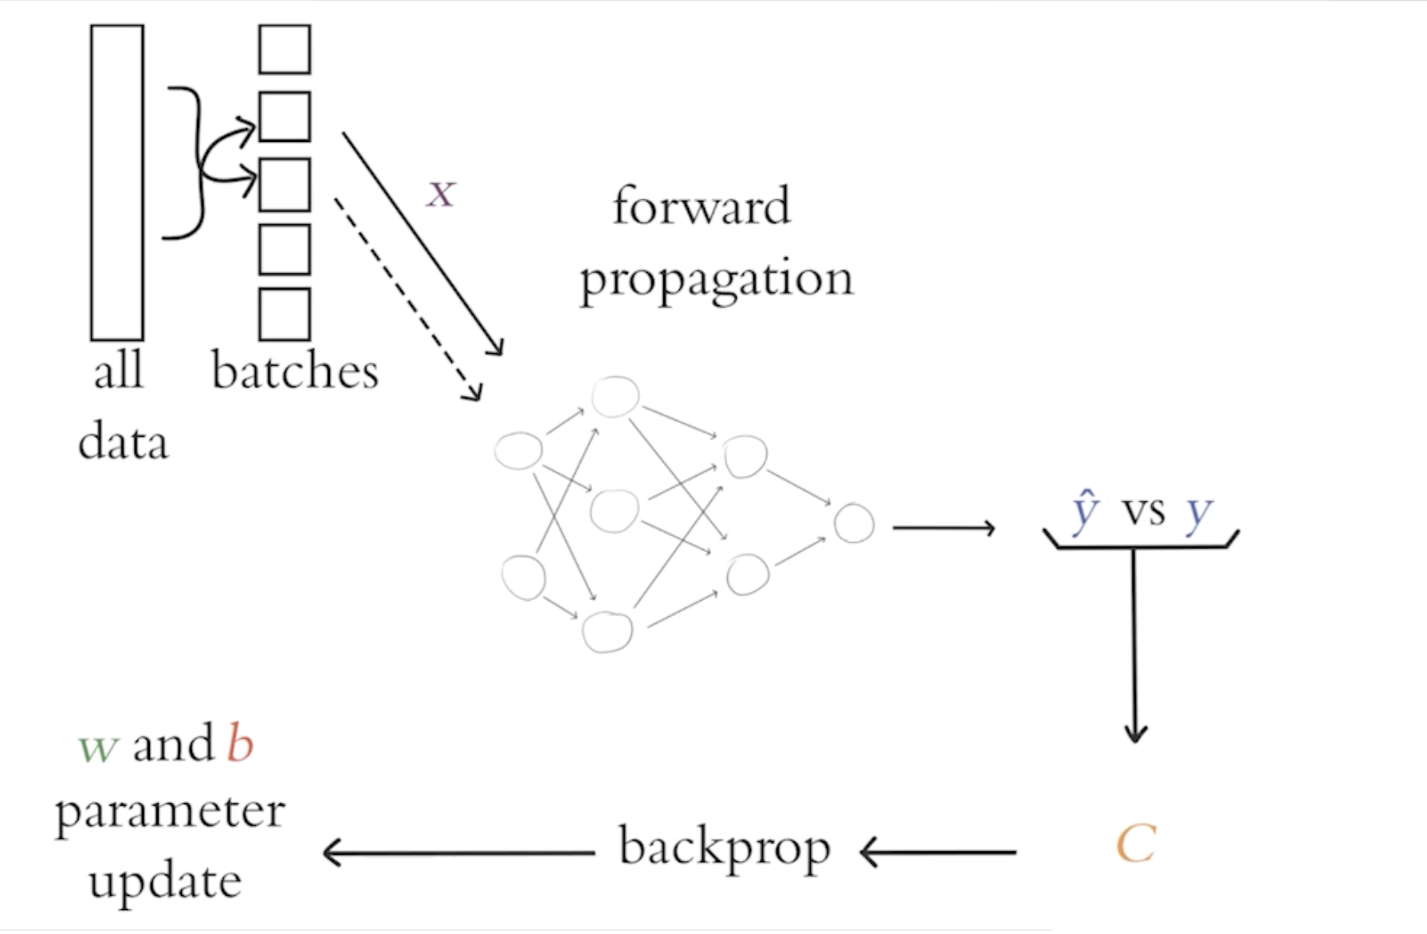
Each round of Epoch
1. Sample a mini batch of values
2. Forward Propogate X to calculate y^
3. Calculate Cost C
4. BackProp to do gradient descent of C to adjust w and b

Slide 18
Forward Propagation
Initialize weights and bias randomly
Calculate Weighted sum and bias and feed forward
A1
W1
A4
w2
X1
w6
A2
Y^
w4
X2
A5
w5
A3
w6
B=0

Slide 19
Backward Propagation
Define Cost Function
During Backward propagation, Deep Learning uses Gradient Descent Algorithm to find optimized weights and biases
Learning rat e dictates how fast gradients will move (0.01 vs 0.1)

Slide 20
Thumb Rule Number of hidden layers Simple problems: For linearly separable data, you might not need any hidden layers at all. If the data is less complex or has a low number of dimensions, one to two hidden layers might suffice. Complex problems: For tasks with a large number of features or intricate patterns, consider using three to five hidden layers. Overfitting: Be cautious with increasing the number of layers, as this can increase model complexity and lead to overfitting, especially with smaller datasets. Too many layers can also significantly worsen serving latency. Backpropagation: It can be difficult to train a network with more than one hidden layer using backpropagation. Number of neurons per hidden layer General guideline: A good starting point is to choose a number of hidden neurons between the size of the input layer and the size of the output layer. 2/3 rule: A commonly cited rule of thumb is to use 2/3 the size of the input layer plus the size of the output layer. Twice the input rule: Another suggestion is to use less than twice the size of the input layer. Progressive reduction: In deeper networks, consider progressively decreasing the number of neurons in subsequent layers to extract features and get closer to the target class.

Slide 21
CPU Vs GPU Demo

Slide 22
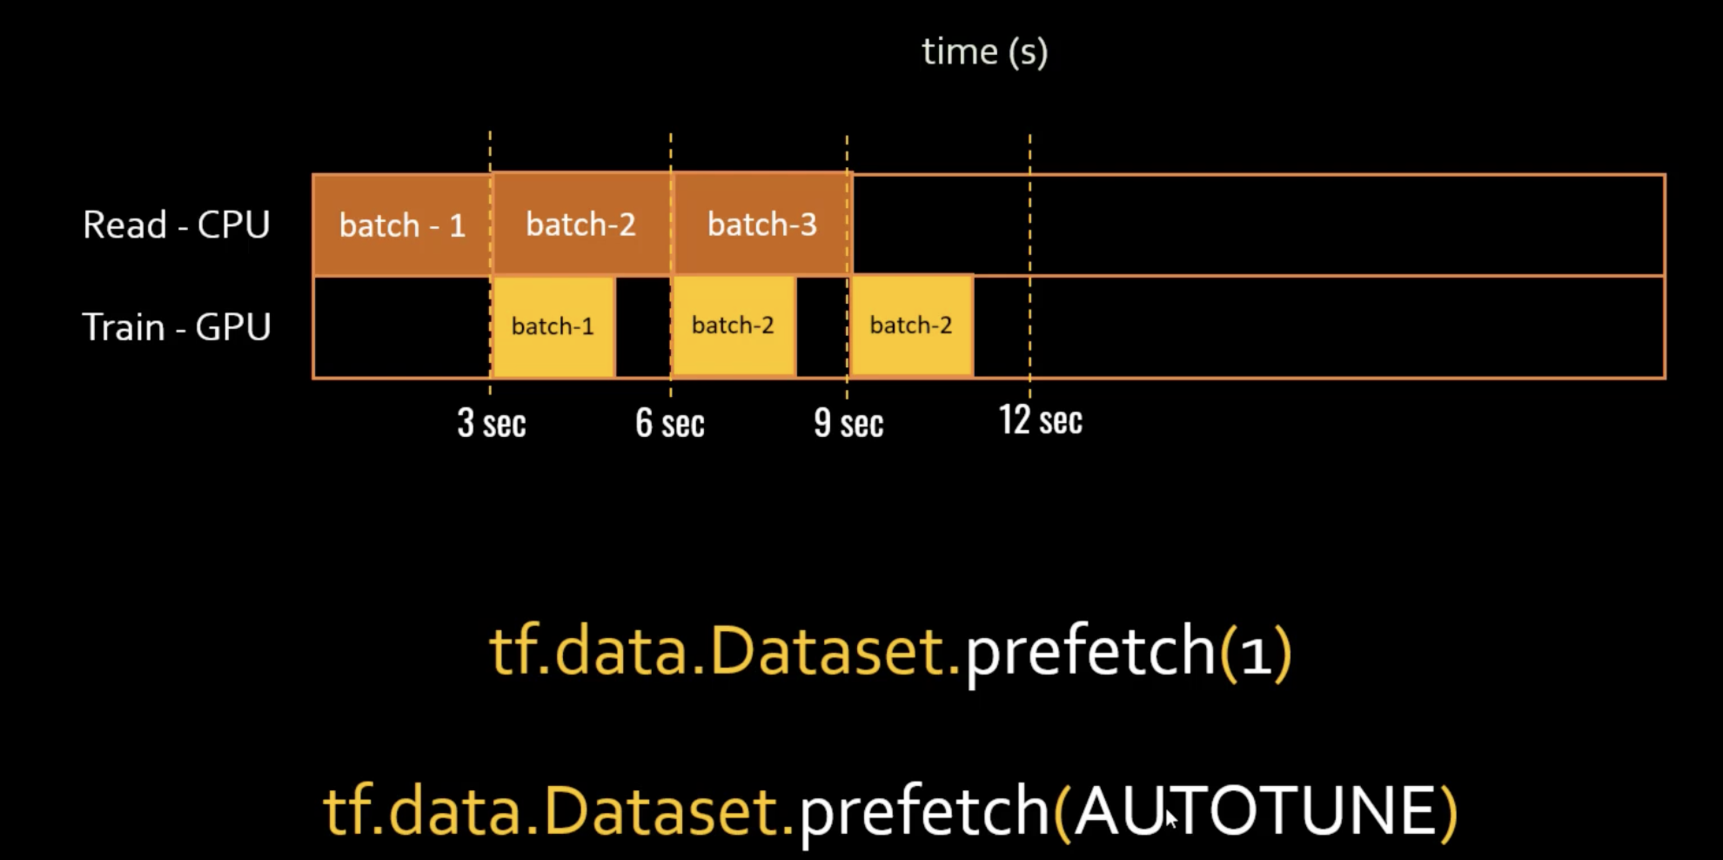
Training Optimization
Prefetch
Caching
Parellism
Model - the division of the neural network into parts and assigning each part to a different computer
Data - data into batches & assigns each batch to a different computer
Hybrid Parellelism
Torch.Tensor / Numba Datatypes

Slide 23
Post training optimization
Quantization
Pruning (Removing unimportant weights to Zero)
Compiler Optimization:
Utilizing specialized deep learning compilers (e.g., TVM, OpenVino, TensorRT) to optimize the model's computational graph and generate highly efficient code for specific target hardware (e.g., GPUs, FPGAs, ASICs). These compilers can perform various graph-level transformations and optimizations like layer fusion, kernel optimization, and memory management.

